Slide 1
Intro to Python Week 4

Slide 2
Overview
if Statement
if ….. Else ….
Nested if

Slide 3
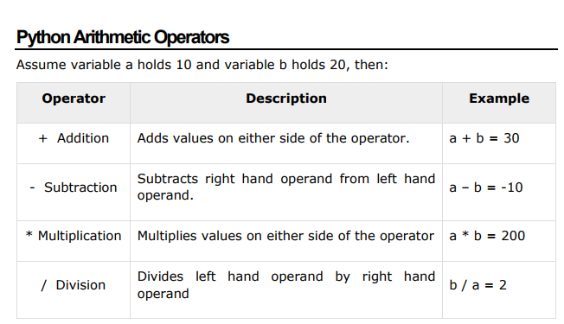
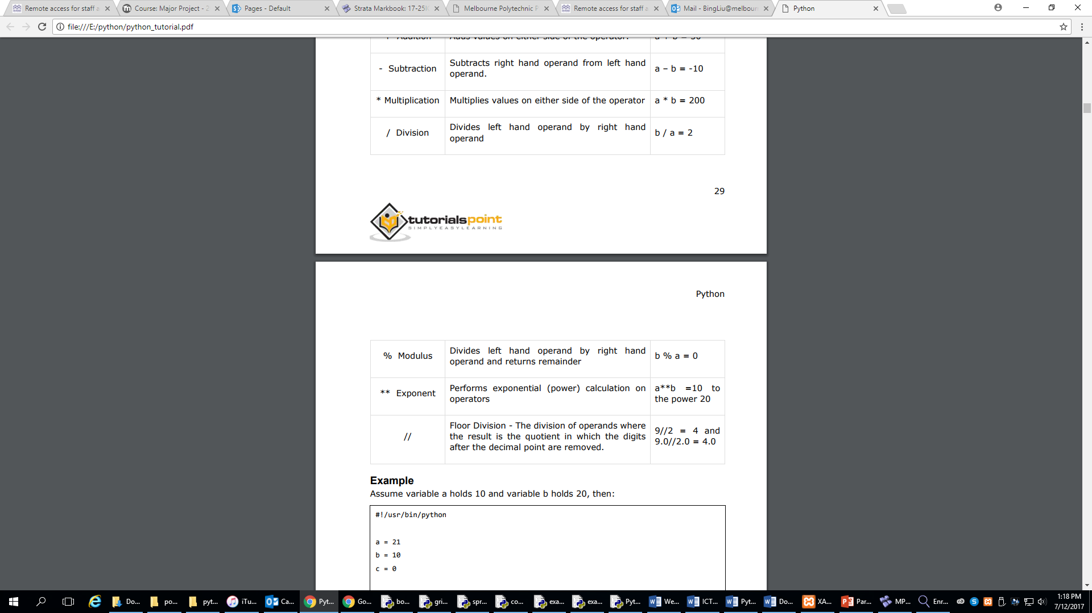
Operators

Slide 4
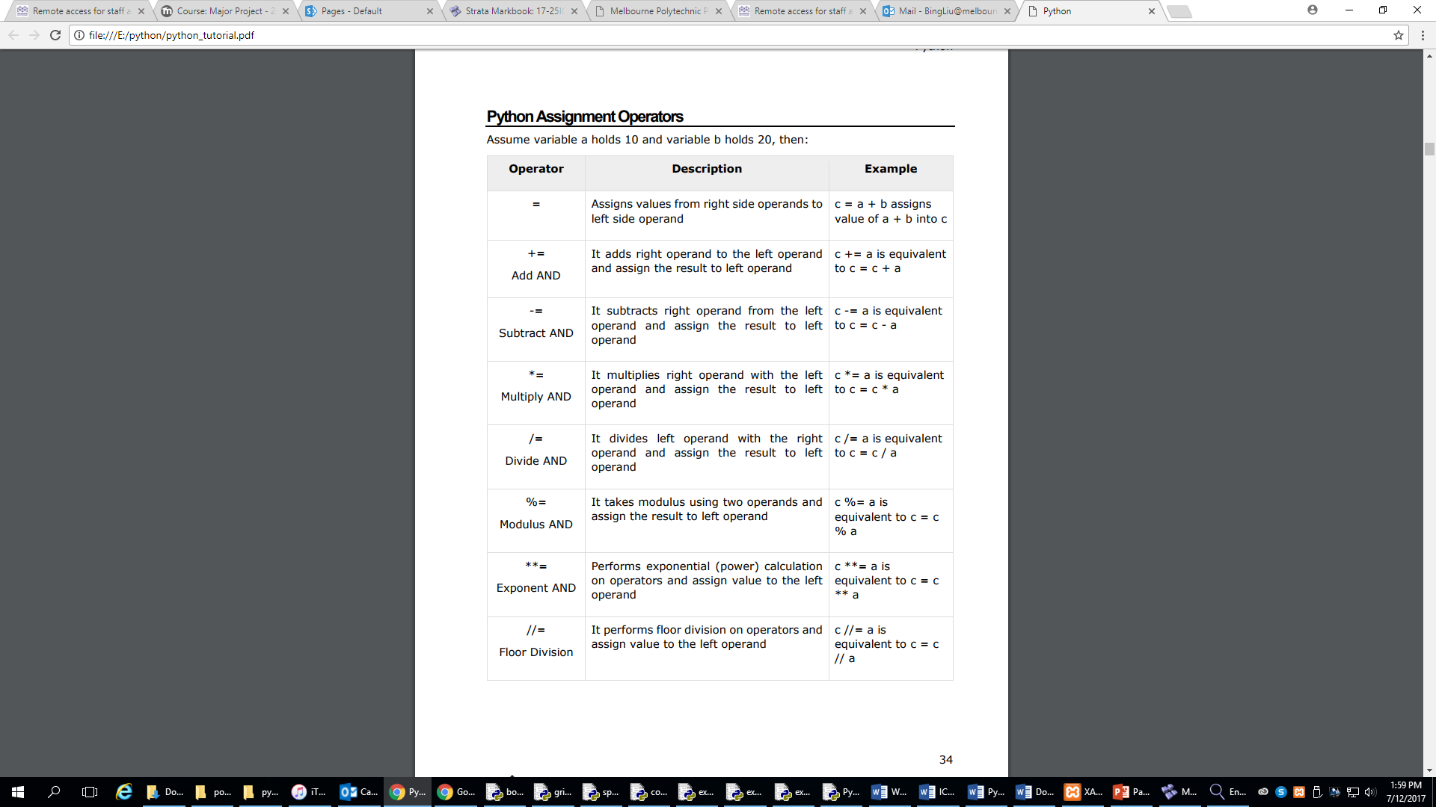
Assignment Operators

Slide 5
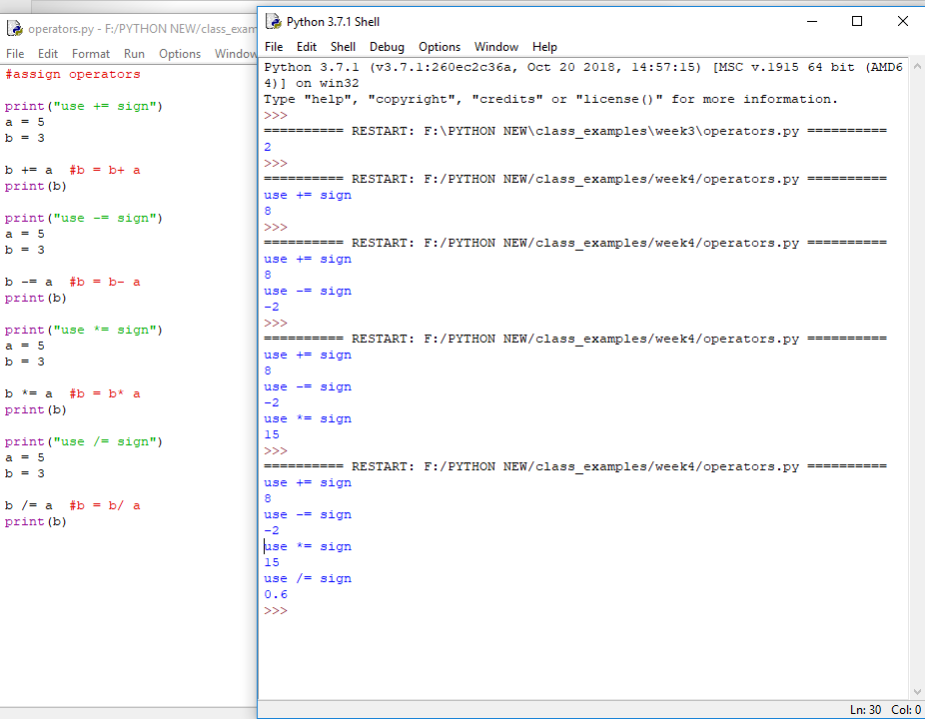
Assignment Operators Example

Slide 6
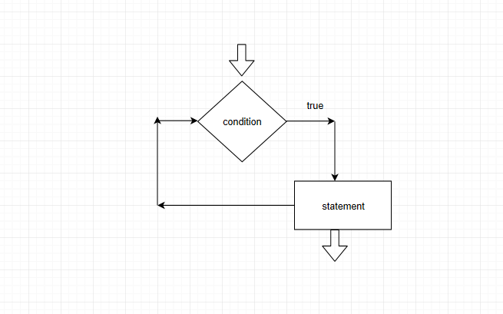
If statement
The if statement contains a logical expression using which data is compared and a decision is made based on the result of the comparison.
If the Boolean expression evaluates to TRUE, then the block of statement(s) inside the if statement is executed. If Boolean expression evaluates to FALSE, then the first set of code after the end of the if statement(s) is executed.
Syntax:
if expression:
statement(s)

Slide 7
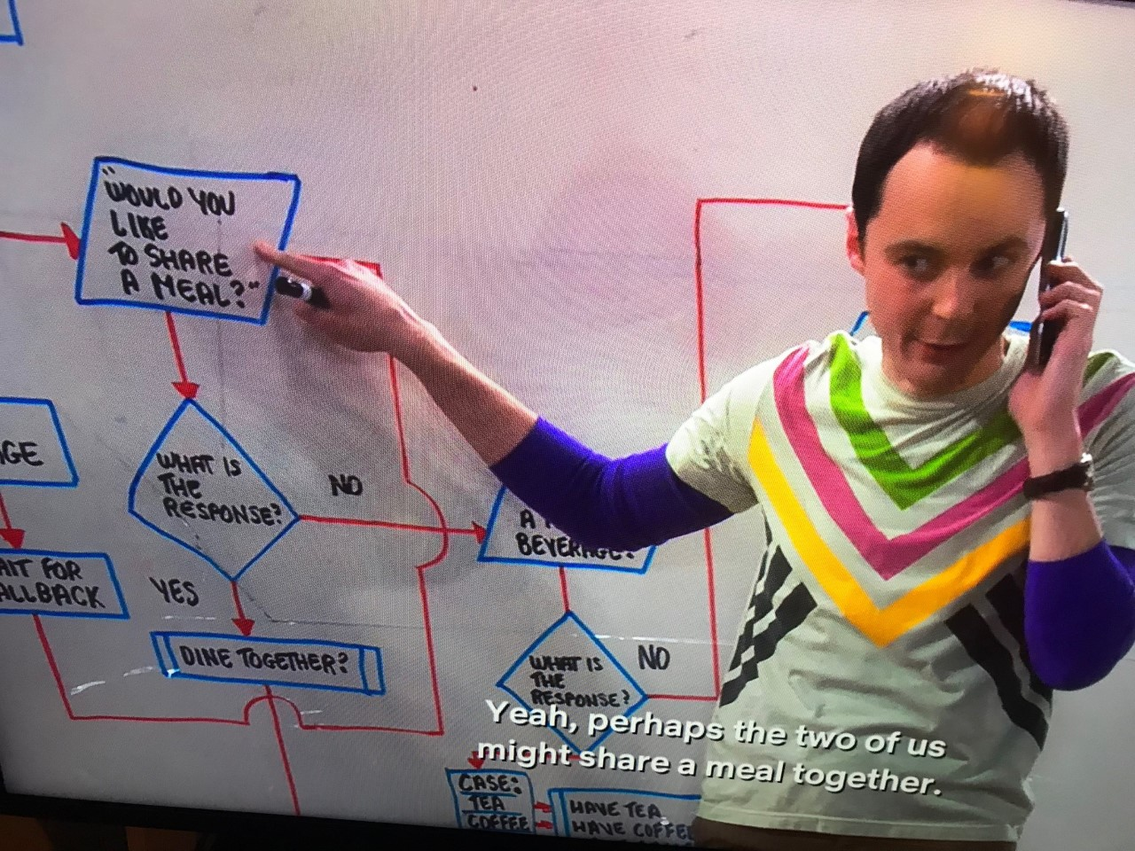
If statement

Slide 8
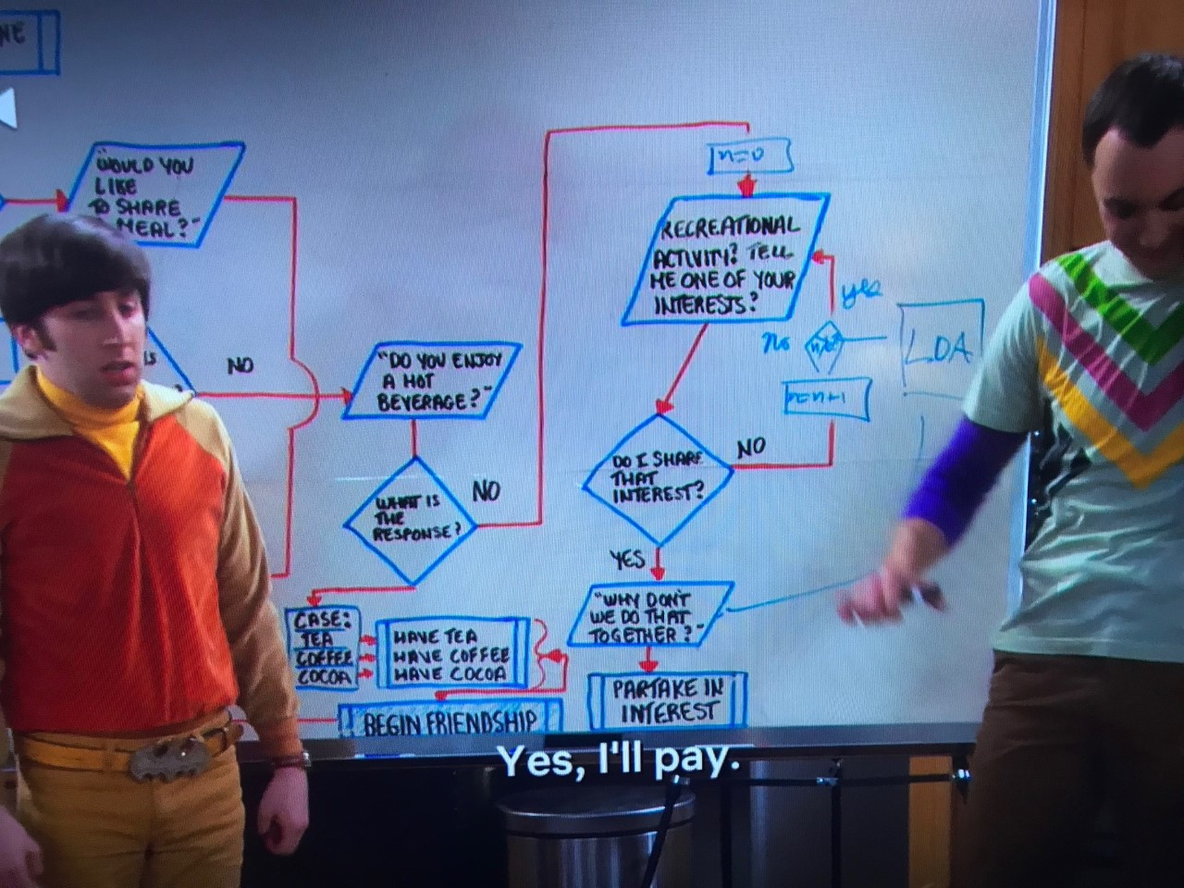

Slide 9


If statement example
number = raw_input("Please create a number ")
if number> 0:
print("The number is positive")
Input a number
Keyboard input a number
If number >0
IF number is granter than 0
Display message
Print “The number is positive
Display a message
END
End Terminal

Slide 10
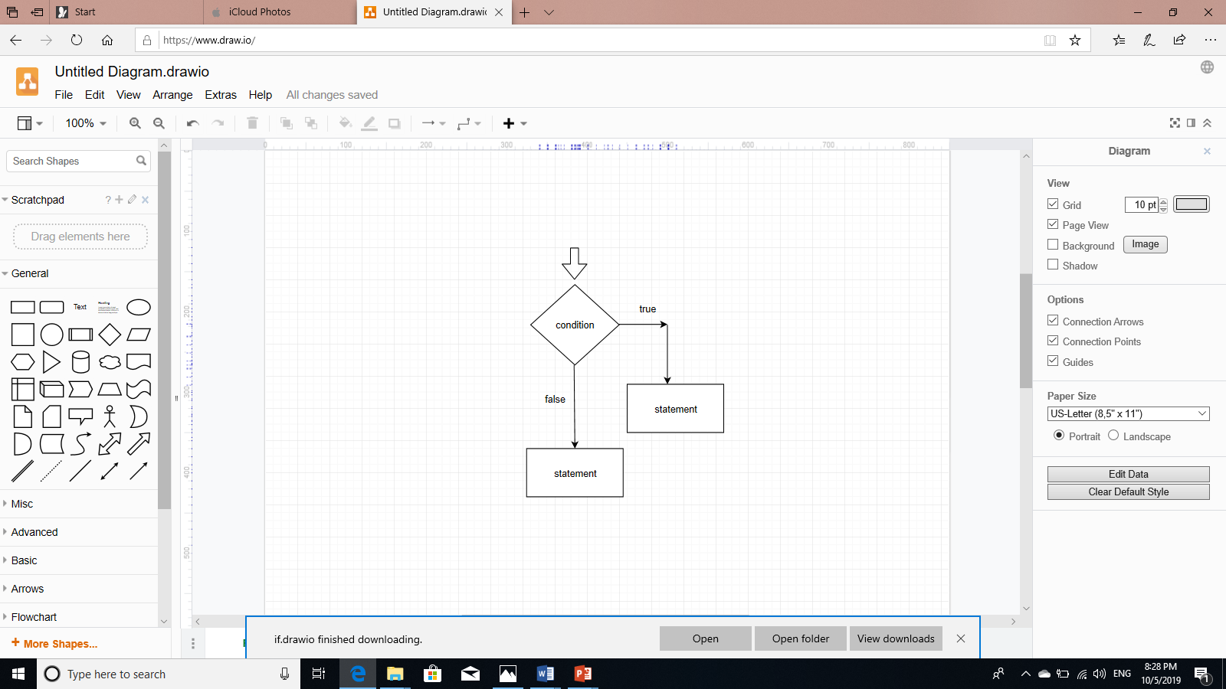
if…..else….
The else statement is an optional statement and there could be at most only one else statement following if
Syntax:
if expression:
statement(s)
else:
statement(s)

Slide 11
Example of if …. else …..
number = 10
if number> 0:
print("The number is positive")
else:
print("The number is not positive")

Slide 12
Flowchart and Pseudocode
START
Input a number
START Terminal
Keyboard INPUT a number
IF number granter than 0
PRINT “Number is positive”
ELSE
PRINT “Number is NOT positive”
If number >0
Display true statement
Display true statement
Display false statement
Display false statement
END

Slide 13
if…..elif….
The elif statement is an multiple optional statement and there could be more conditions.
Similar to the else, the elif statement is optional. However, unlike else, for which
there can be at most one statement, there can be an arbitrary number of elif statements following an if.
Syntax:
if expression1:
statement(s)
elif expression2:
statement(s)
elif expression3:
statement(s)
else:
statement(s)

Slide 14
if .. elif statement example
#elif statement
month = input("Please enter a month: “)
if month == 1 :
print "This month is January"
elif month == 2:
print "This month is February"
elif month == 3:
print "This month is March"
else:
print "Invalid input"
If number >0
Display message

Slide 15
Logical Operators
Operator | Description | Example
or (OR) | If any of the two operands are non-zero then condition becomes true. | (a or b) is true.
and(AND) | If both the operands are true then condition becomes true. | (a and b) is true.
not(NOT) | Used to reverse the logical state of its operand. | NOT age==18
If number >0
Display message

Slide 16
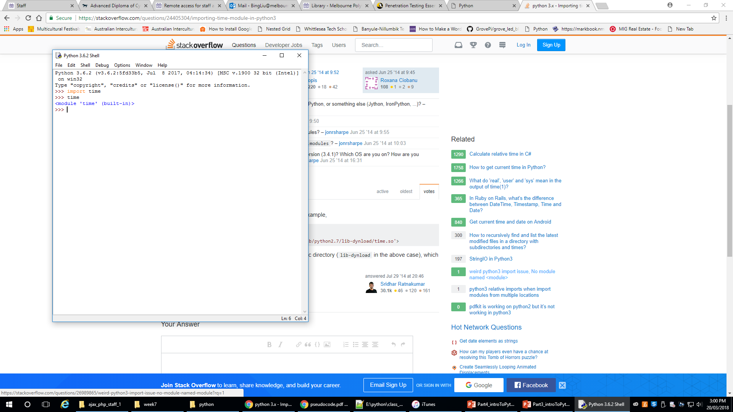
Import Module
There is a built-in module called time in Python, so you need to import it into your program

Slide 17

grovepi
The GrovePi is an Internet of Things Raspberry Pi robot kit that comes with 12 sensors and modules for creating your own smart devices.

Slide 18
Example of using grovepi
import time
from grovepi import *
num = raw_input("Please enter a number: ")
number = int(num)
if number%2 ==0:
led = 2 #LED in D2 on
pinMode(led, "OUTPUT")
digitalWrite(led, 1)
time.sleep(5)
digitalWrite(led, 0)
else:
led=4 #LED in D4 on
pinMode(led, "OUTPUT")
digitalWrite(led, 1)
time.sleep(5)
digitalWrite(led, 0)

Slide 19
Example 2– Flowchart and Pseudocode
START
START Terminal
Import time and grovepi
Assign num
IF num is even
ledPin = 2
light on 5 seconds
light off
ELSE
ledPin = 4
light on 5 seconds
light off
END Terminal
Import time and grovepi , assign num
Apply function to str, sub
If num%2 ==0
Display true statement
Display false statement
Display a message
END

Slide 20
Reference
www.tutorialspoint.com
http://twitter.com/tutorialspoint
If number >0
Display message

